Slide 1
Binary Classification and Performance Measures

Slide 2
Examples of Binary Classification

Slide 3
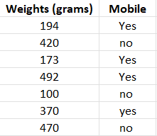
Example 1
Dataset
Given weights calculate the probability that an item whose weight is 378 grams is Mobile. i.e.
b0=28.12 and b1=-0.23.
P(mobile|weight=378)=?
P(mobile|weight=200)=?
P(mobile|weight=150)=?
P(mobile|weight=350)=?
P(mobile|weight=490)=?
Notes:
Formula: y = e^(b0 + b1*x) / (1 + e^(b0 + b1*x))

Slide 4
Example 1
Dataset
Given weights calculate the probability that an item whose weight is 378 grams is Mobile. i.e.
b0=28.12 and b1=-0.23.
P(mobile|weight=378)=?
Formula: y = e^(b0 + b1*x) / (1 + e^(b0 + b1*x))

Slide 5
Example 2 - Churn Prediction
Churn is defined in business terms as ‘when a client cancels a subscription to a service they have been using.’ A common example is people canceling Spotify/Netflix subscriptions.
Churn Prediction is essentially predicting which clients are most likely to cancel a subscription i.e. leave a company based on their usage of the service.
The output in the case of Churn prediction is a simple yes or a no. Therefore, it is a classification problem where you have to predict 1 if the customer is likely to churn and 0 otherwise.
Given a dataset having 16 features, we have to create a binary classification model that predicts whether a customer will cancel the subscription in the coming days.

Slide 6
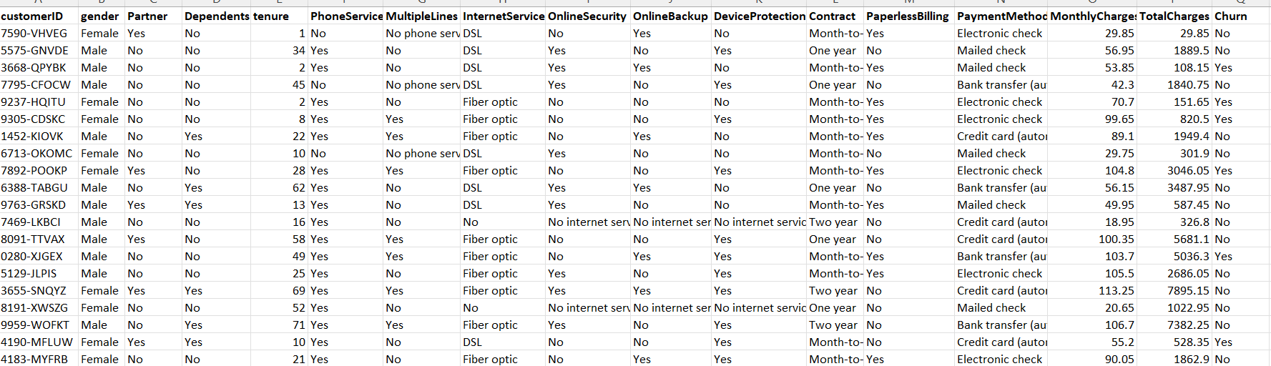
Churn Prediction
Dataset of Churn Prediction

Slide 7
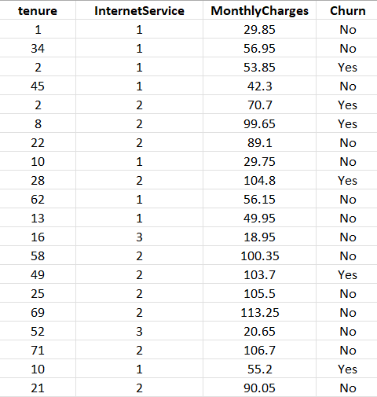
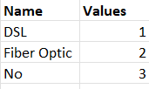
Churn Prediction
After Dataset Preprocessing
For such dataset, what would be my logistic regression formula?
How many coefficients(b’s) should be learned by our model?

Slide 8
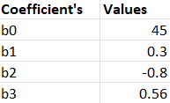
We have learned the coefficients below.
Below is an example logistic regression equation:
y = e^(b0 + b1*x1 + b2*x2 + b3*x3 ) / (1 + e^(b0 + b1*x + b2*x2 + b3*x3 ))
Using the equation above we can calculate the probability of churn given a tenure=24, Internet Service= DSL, and Monthly Charges= 108.34.
More formally P(churn|tenure=24,InternetService=DSL,MonthlyCharges=108.34) = ?

Slide 9
Performance Measures

Slide 10
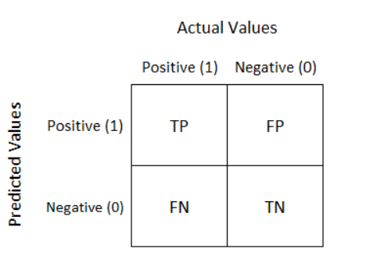
Confusion Matrix
A confusion matrix is a performance measurement technique for Machine learning classification.
It is an N x N matrix used for evaluating the performance of a classification model, where N is the number of target classes.
For a binary classification problem, it is a two-by-two table that contains four outcomes produced by a binary classifier.

Slide 11
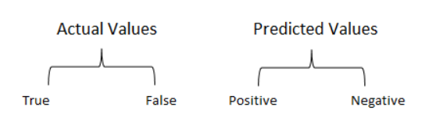
Confusion Matrix
True Positive(TP):
Interpretation: You predicted positive and it’s true.
You had predicted that France would win the world cup, and it won.
True Negative(TN):
Interpretation: You predicted negative and it’s true.
You had predicted that England would not win, and it lost.
False Positive(FP): (Type 1 Error)
Interpretation: You predicted positive and it’s false.
You had predicted that England would win, but it lost.
False Negative(FN): (Type 2 Error)
Interpretation: You predicted negative and it’s false.
You had predicted that France would not win, but it won.
Just Remember, We describe predicted values as Positive and Negative and actual values as True and False.

Slide 12
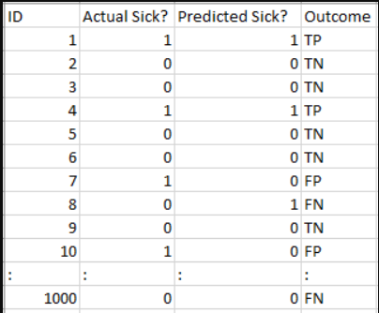
Example 1

Slide 13
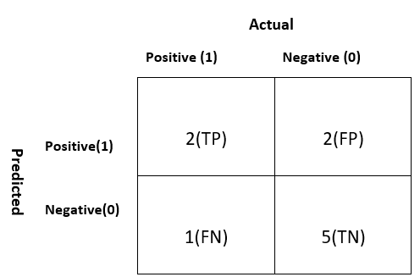
Example 1
Total
4
6
Total
3
7
10

Slide 14
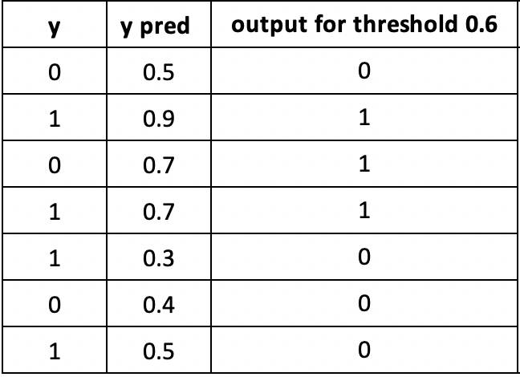
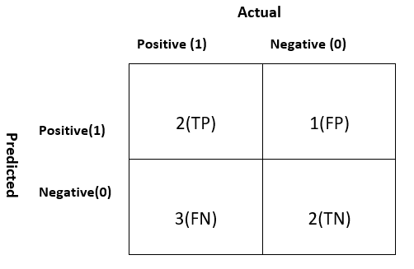
Example 2
TN
TP
FP
TP
FN
TN
FN

Slide 15
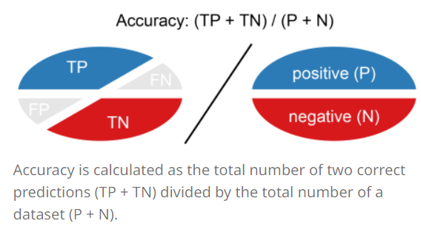
Accuracy
Accuracy (ACC) is calculated as the number of all correct predictions divided by the total number of the dataset.
The best accuracy is 1.0, whereas the worst is 0.0.
Overall, how often is the classifier correct?

Slide 16

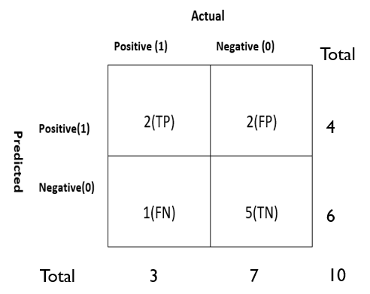
Accuracy(cont)
The accuracy would be calculated by the following formula
ACC= (2+5)/10 = 0.7
So the model is saying I can predict sick people 70% of the time.

Slide 17
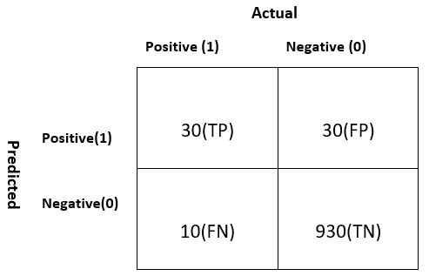
ACCURACY(cont)
Let’s take another example.
Total
ACC=(TP+TN)/P+N = (30+930)/1000 = 0.96
60
Our model is saying “I can predict sick people 96% of the time”.
940
Total
40
960
1000
Notes:
However, it is doing the opposite. It is predicting the people who will not get sick with 96% accuracy while the sick are spreading the virus! Do you think this is a correct metric for our model given the seriousness of the issue? Shouldn’t we be measuring how many positive cases we can predict correctly to arrest the spread of the contagious virus? Or maybe, out of the correctly predicted cases, how many are positive cases to check the reliability of our model?
This is where we come across the dual concept of Precision and Recall.

Slide 18
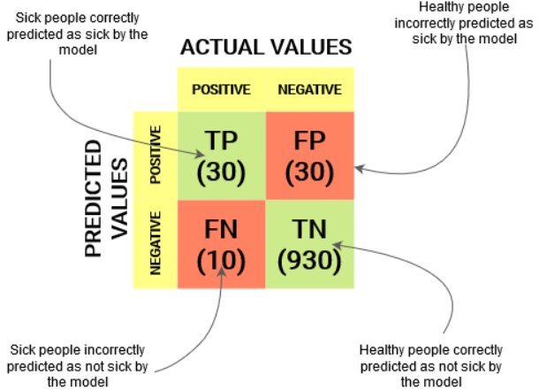
Confusion Matrix

Slide 19
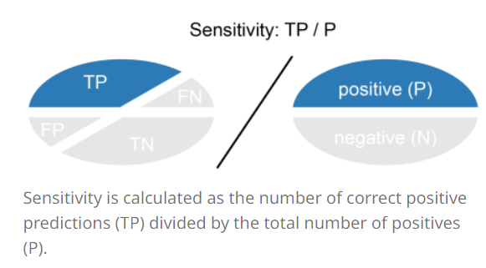
Recall
Recall (REC) is calculated as the number of correct positive predictions divided by the total number of positives.
It is also called sensitivity (SN) or true positive rate (TPR).
The best recall is 1.0, where as the worst is 0.0.
Recall tells us how many of the actual positive cases we were able to predict correctly with our model.

Slide 20
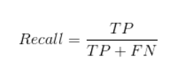
Recall(CONT)
The recall would be calculated by the following formula
Total
60
REC= 30/(30+10) = 0.75
940
75% of the positives were successfully predicted by our model. Awesome!
Total
40
960
1000
Notes:
Recall is a useful metric in cases where False Negative trumps False Positive.
Recall is important in medical cases where it doesn’t matter whether we raise a false alarm but the actual positive cases should not go undetected!
In our example, Recall would be a better metric because we don’t want to accidentally discharge an infected person and let them mix with the healthy population thereby spreading the contagious virus. Now you can understand why accuracy was a bad metric for our model.

Slide 21
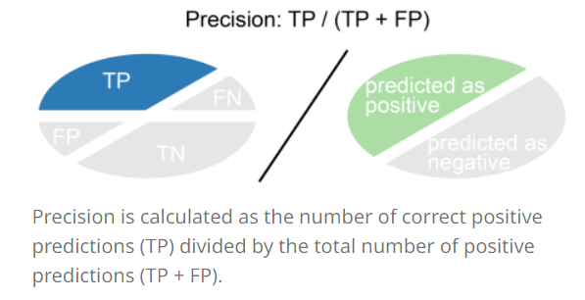
Precision
Precision (PREC) is calculated as the number of correct positive predictions divided by the total number of positive predictions.
It is also called positive predictive value (PPV).
The best precision is 1.0, whereas the worst is 0.0.
Precision tells us how many of the correctly predicted cases actually turned out to be positive.

Slide 22

Precision(cont.)
The precision would be calculated by the following formula
Total
Precision= 30/(30+30)
60
50% percent of the correctly predicted cases turned out to be positive cases
This would determine whether our model is reliable or not.
940
Total
40
960
1000
Notes:
Precision is a useful metric in cases where False Positive is a higher concern than False Negatives.
Precision is important in music or video recommendation systems, e-commerce websites, etc. Wrong results could lead to customer churn and be harmful to the business.

Slide 23
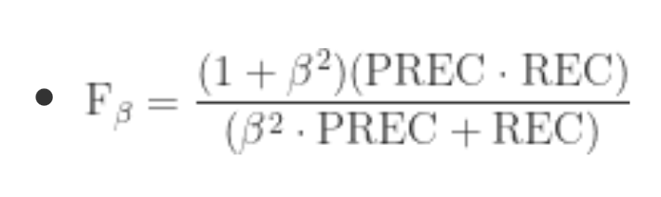
F-score
In practice, when we try to increase the precision of our model, the recall goes down, and vice-versa.
The F1-score captures both the trends in a single value.
F1-score is a harmonic mean of Precision and Recall, and so it gives a combined idea about these two metrics.
It is maximum when Precision is equal to Recall.

Slide 24
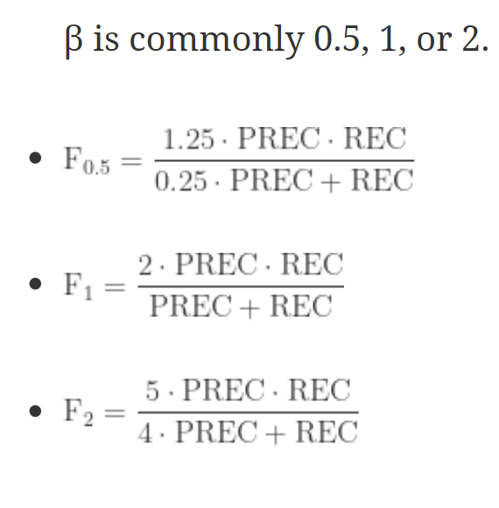
F-score(cont)
Notes:
But there is a catch here. The interpretability of the F1-score is poor. This means that we don’t know what our classifier is maximizing – precision or recall? So, we use it in combination with other evaluation metrics which gives us a complete picture of the result.

Slide 25
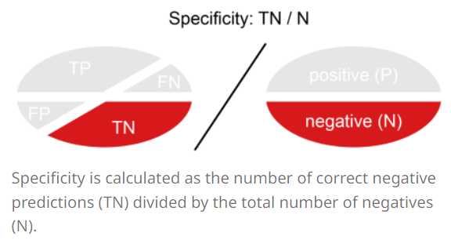
Specificity (True negative rate)
Specificity (SP) is calculated as the number of correct negative predictions divided by the total number of negatives.
It is also called true negative rate (TNR).
The best specificity is 1.0, whereas the worst is 0.0.

Slide 26

Specificity (True negative rate)
The specificity would be calculated by the following formula
Total
60
SP=930/960 = 0.96
940
Total
40
960
1000

Slide 27
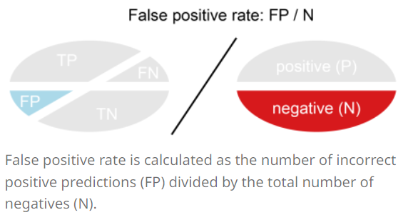
False positive rate
False positive rate (FPR) is calculated as the number of incorrect positive predictions divided by the total number of negatives.
The best false positive rate is 0.0 whereas the worst is 1.0.
It can also be calculated as 1 – specificity.

Slide 28

False positive rate
The specificity would be calculated by the following formula
Total
60
FPR=30/960 = 0.031
940
Total
40
960
1000

Slide 29
Quiz
Actual Flu | Predicted Flu
1 | 1
1 | 0
0 | 1
1 | 0
0 | 1
0 | 0
1 | 1
1 | 0
0 | 1
0 | 1
1 | 0
1 | 1
Calculate (1 = Stay | 0 = Leave)
Accuracy
F-Score
Precision
Recall
Sensitivity
Specificity
Comment on the quality of model (Logically)
Which measure is most appropriate here

